Slide 1
The Rest of ReST
@dylanbeattie
Notes:
Everybody stand up
Remain standing if you've ever built an HTTP API
Remain standing if you've built an API that supports HTTP DELETE
Remain standing if you've built an API that supports HTTP PATCH
Remain standing if you've ever made an API change that's broken a customer system

Slide 2
"When given a name, a coordinated set of architectural constraints
becomes an architectural style"

Slide 3
"REST is software design on the scale of decades : every detail is intended to promote software longevity and independent evolution.
Many of the constraints are directly opposed to short-term efficiency."

Slide 4
ReST: The Constraints
Client-server
Stateless
Cacheable
Layered System
Code-on-demand
Uniform interface
Hypermedia as the engine of application state

Slide 5
ReST: The Constraints
Client-server
Stateless
Cacheable
Layered System
Code-on-demand
Uniform interface
Hypermedia as the engine of application state
This bit is optional.

Slide 6
"We need to start building NOW! We can't wait until your API is ready"
"I know you said it's a work in progress, but your API changes keep breaking our build"
Notes:
OK, let's kick things off... you're building an API, but the clock is ticking and we're on deadline.

Slide 7

apiary.io
https://apiary.io/
Rapid prototyping for web APIs

Slide 8
FrienNDC
A Social Network for NDC Attendees

Slide 9
GET /profiles HTTP/1.1
200 OK
Content-Type: application/json
[
{
"id": 1,
"name": "Dylan Beattie",
"twitter": "@dylanbeattie"
}
]

Slide 10
POST /profiles HTTP/1.1
{
"name": "Mark Rendle",
"twitter": "@markrendle"
}
201 Created
Location: http://api.friendc.no/profiles/2
{
"id": 2,
"name": "Mark Rendle",
"twitter": "@markrendle"
}

Slide 11
GET /profiles HTTP/1.1
200 OK
Location: http://api.friendc.no/profiles/2
[
{ "id": 1, "name": "Dylan Beattie", "twitter": "@dylanbeattie" }
{ "id": 2, "name": "Mark Rendle", "twitter": "@markrendle" },
{ "id": 3, "name": "Ian Cooper", "twitter": "@icooper" },
.
.
.
.
{ "id": 2145, "name": "Toby Henderson", "twitter": "@holytshirt" }
]

Slide 12
"Your API is using all our bandwidth!"
"Your API is hammering our database!"

Slide 13
GET /profiles?page=1 HTTP/1.1
200 OK
[
{ "id": 1, "name": "Dylan Beattie", "twitter": "@dylanbeattie" }
{ "id": 2, "name": "Mark Rendle", "twitter": "@markrendle" },
{ "id": 3, "name": "Ian Cooper", "twitter": "@icooper" },
.
.
.
.
{ "id": 50, "name": "Udi Dahan", "twitter": "@udidahan" }
]

Slide 14
GET /profiles?page=2 HTTP/1.1
200 OK
GET /profiles?page=3 HTTP/1.1
200 OK
GET /profiles?page=4 HTTP/1.1
200 OK
GET /profiles?page=5 HTTP/1.1
204 No Content
NOT ReST

Slide 15
ReST: The Constraints
Client-server
Stateless
Cacheable
Layered System
Code-on-demand
Uniform interface
Hypermedia as the engine of application state

Slide 16

www.vintagecomputing.com

Slide 17
Choose Your Own Adventure: NDC Oslo 2015
You have been at the NDC Oslo after-party for three hours now. You've watched the band, and had a couple of beers, and met lots of really interesting people. Now the party is starting to wind down. The bar will be open for another half-hour, though – and Liam from Huddle is talking about going to an Irish whiskey bar he's heard about.
To go to the bar with Liam, go to page 74 To stay at the party and have another beer, go to page 23
To go back to your hotel and get some sleep, go to page 41

Slide 18
GET /profiles HTTP/1.1
200 OK
Content-Type: application/hal+json
{
"_links" : {
"self" : { "href" : "http://my.api/profiles?page=1" },
"next" : { "href" : "http://my.api/profiles?page=2" },
"last" : { "href" : "http://my.api/profiles?page=214" }
},
"items:" [ { "id": 1, "name": "Dylan Beattie", "twitter": "@dylanbeattie" }
{ "id": 2, "name": "Mark Rendle", "twitter": "@markrendle" },
{ "id": 3, "name": "Ian Cooper", "twitter": "@icooper" }, . .
{ "id": 10, "name": "Udi Dahan", "twitter": "@udidahan" }
]
}

Slide 19
GET /profiles/1 HTTP/1.1
200 OK
Content-Type: application/json
{ "id": 1, "name": "Dylan Beattie", "twitter": "@dylanbeattie", "friends" : [ { "id": 5, "name": "Ian Cooper", "twitter" : "@icooper" }, { "id": 6, "name": "Toby Henderson", "twitter" : "@holytshirt" }, { "id": 9, "name": "Liam Westley", "twitter", "@westleyl" }, // another 500 friends here... ]
}

Slide 20
GET /profiles/1 HTTP/1.1
200 OK
Content-Type: application/json
{ "id": 1, "name": "Dylan Beattie", "twitter": "@dylanbeattie", "friends" : [ { "id": 5, "name": "Ian Cooper", "twitter" : "@icooper" }, { "id": 6, "name": "Toby Henderson", "twitter" : "@holytshirt" }, { "id": 9, "name": "Liam Westley", "twitter", "@westleyl" }, // another 500 friends here... ],
"updates" : [ { "id" : 2792676, "message": "Having a great time at NDC!", "date" : "2012-04-23T18:25:43.511Z" }, { "id" : 2978967, "message": "Wow – Oslo is still light at 11pm", "date" : "2012-04-23T18:25:43.511Z" }, { "id" : 2982341, "message": "About to give my talk on REST", "date" : "2012-04-23T18:25:43.511Z" } ]
}

Slide 21
GET /profiles/1 HTTP/1.1
200 OK
Content-Type: application/json
{ "id": 1, "name": "Dylan Beattie", "twitter": "@dylanbeattie", "friends" : [ { "id": 5, "name": "Ian Cooper", "twitter" : "@icooper", "updates" : [ { "id" : 2792676, "message": "NDC is awesome!", "date" : "2012-04-23T18:25:43.511Z" }, { "id" : 2978967, "message": "Heading back to London", "date" : "2012-04-23T18:25:43.511Z" }, ] }, { "id": 6, "name": "Toby Henderson", "twitter" : "@holytshirt" "updates" : [ { "id" : 2792676, "message": "NDC is awesome!", "date" : "2012-04-23T18:25:43.511Z" }, { "id" : 2978967, "message": "Heading back to London", "date" : "2012-04-23T18:25:43.511Z" }, ] }, { "id": 9, "name": "Liam Westley", "twitter", "@westleyl" "updates" : [ { "id" : 2792676, "message": "NDC is awesome!", "date" : "2012-04-23T18:25:43.511Z" }, { "id" : 2978967, "message": "Heading back to London", "date" : "2012-04-23T18:25:43.511Z" }, ] }, ], "updates" : [ { "id" : 2792676, "message": "Having a great time at NDC!", "date" : "2012-04-23T18:25:43.511Z" }, { "id" : 2978967, "message": "Wow – Oslo is still light at 11pm", "date" : "2012-04-23T18:25:43.511Z" }, { "id" : 2982341, "message": "About to give my talk on REST", "date" : "2012-04-23T18:25:43.511Z" } ] }
}

Slide 22
GET /profiles/1 HTTP/1.1
200 OK
Content-Type: application/json
{ "id": 1, "name": "Dylan Beattie", "twitter": "@dylanbeattie", "friends" : [ { "id": 5, "name": "Ian Cooper", "twitter" : "@icooper", "updates" : [ { "id" : 2792676, "message": "NDC is awesome!", "date" : "2012-04-23T18:25:43.511Z" }, { "id" : 2978967, "message": "Heading back to London", "date" : "2012-04-23T18:25:43.511Z" }, ], "friends" : [ { "id": 6, "name": "Toby Henderson", "twitter" : "@holytshirt" "updates" : [ { "id" : 2792676, "message": "NDC is awesome!", "date" : "2012-04-23T18:25:43.511Z" }, { "id" : 2978967, "message": "Heading back to London", "date" : "2012-04-23T18:25:43.511Z" }, ] }, { "id": 9, "name": "Liam Westley", "twitter", "@westleyl" "updates" : [ { "id" : 2792676, "message": "NDC is awesome!", "date" : "2012-04-23T18:25:43.511Z" }, { "id" : 2978967, "message": "Heading back to London", "date" : "2012-04-23T18:25:43.511Z" }, ] }, ], }, { "id": 6, "name": "Toby Henderson", "twitter" : "@holytshirt" "updates" : [ { "id" : 2792676, "message": "NDC is awesome!", "date" : "2012-04-23T18:25:43.511Z" }, { "id" : 2978967, "message": "Heading back to London", "date" : "2012-04-23T18:25:43.511Z" }, ], "friends" : [ { "id": 6, "name": "Toby Henderson", "twitter" : "@holytshirt" "updates" : [ { "id" : 2792676, "message": "NDC is awesome!", "date" : "2012-04-23T18:25:43.511Z" }, { "id" : 2978967, "message": "Heading back to London", "date" : "2012-04-23T18:25:43.511Z" }, ] }, { "id": 9, "name": "Liam Westley", "twitter", "@westleyl" "updates" : [ { "id" : 2792676, "message": "NDC is awesome!", "date" : "2012-04-23T18:25:43.511Z" }, { "id" : 2978967, "message": "Heading back to London", "date" : "2012-04-23T18:25:43.511Z" }, ] }, ], }, { "id": 9, "name": "Liam Westley", "twitter", "@westleyl" "updates" : [ { "id" : 2792676, "message": "NDC is awesome!", "date" : "2012-04-23T18:25:43.511Z" }, { "id" : 2978967, "message": "Heading back to London", "date" : "2012-04-23T18:25:43.511Z" }, ] }, ], "updates" : [ { "id" : 2792676, "message": "Having a great time at NDC!", "date" : "2012-04-23T18:25:43.511Z" }, { "id" : 2978967, "message": "Wow – Oslo is still light at 11pm", "date" : "2012-04-23T18:25:43.511Z" }, { "id" : 2982341, "message": "About to give my talk on REST", "date" : "2012-04-23T18:25:43.511Z" } ] }
}

Slide 23
"Your API is using all our bandwidth... AGAIN!"
"Your API is hammering the database. Again."

Slide 24
GET /profiles/1 HTTP/1.1
200 OK Content-Type: application/hal+json
{
"_links": { "self" : "http://my.api/profiles/1", "friends" : "http://my.api/profiles/1/friends", "photos" : "http://my.api/profiles/1/photos", "updates" : "http://my.api/profiles/1/updates" }, "id": 1, "name" : "Dylan Beattie", "twitter" : "@dylanbeattie", }

Slide 25
GET /profiles/1 HTTP/1.1 200 OK
GET /profiles/1/friends HTTP/1.1 200 OK
GET /profiles/1/updates HTTP/1.1 200 OK
GET /profiles/1/photos HTTP/1.1 200 OK
GET /profiles/1/photos/1234 HTTP/1.1 200 OK
GET /profiles/1/photos/1234/comments HTTP/1.1 200 OK
GET /profiles/1/photos/1345 HTTP/1.1 200 OK
GET /profiles/1/photos/1345/comments HTTP/1.1 200 OK
GET /profiles/1/photos/1456 HTTP/1.1 200 OK
GET /profiles/1/photos/1456/comments HTTP/1.1 200 OK

Slide 26
"I need to make 50 API calls just to draw a web page!"
"Our HTTP traffic just increased 50x - what have you done?"

Slide 27
GET /profiles/1?expand=updates HTTP/1.1
200 OK Content-Type: application/json
{
"_links": { "self" : "http://my.api/profiles/1", "friends" : "http://my.api/profiles/1/friends", "photos" : "http://my.api/profiles/1/photos", "updates" : "http://my.api/profiles/1/updates" }, "id": 1, "name" : "Dylan Beattie", "twitter" : "@dylanbeattie"
"_embedded" : { "updates" : [ { "id" : 2792676, "message": "Having a great time at NDC!", "date" : "2012-04-23T18:25:43.511Z" }, { "id" : 2978967, "message": "Wow – Oslo is still light at 11pm", "date" : "2012-04-23T18:25:43.511Z" }, { "id" : 2982341, "message": "About to give my talk on REST", "date" : "2012-04-23T18:25:43.511Z" } ] } }

Slide 28
GET /profiles/1 HTTP/1.1
200 OK Content-Type: application/json
{
"_links": { "self" : "http://my.api/profiles/1", "friends" : "http://my.api/profiles/1/friends", "photos" : "http://my.api/profiles/1/photos", "updates" : "http://my.api/profiles/1/updates" }, "id": 1, "name" : "Dylan Beattie", "twitter" : "@dylanbeattie", "height" : 180, "weight" : 95, "location" : { "lat": 59.912854, "lon": 10.7536 }, "status" : "Talking about REST at NDC Oslo", "hometown" : "London, GB" "email" : "dylan@dylanbeattie.net", "website" : "www.dylanbeattie.net", "birthdate" : "1978-08-22", "last_modified" : "2015-06-18T15:25:43.511Z"
}

Slide 29
PUT /profiles/1 HTTP/1.1
Content-Type: application/json
{ "name" : "Dylan Beattie", "twitter" : "@dylanbeattie", "height" : 180, "weight" : 95, "location" : { "lat": 59.912854, "lon": 10.7536 }, "status" : "Talking about HTTP PUT", "hometown" : "London, GB" "email" : "dylan@dylanbeattie.net", "website" : "www.dylanbeattie.net", "birthdate" : "1978-08-22", }
409 Conflict

Slide 30
"Why do I need to PUT the entire profile just to update location?
"My updates keep failing with a 409 Conflict! Help!"

Slide 31
PUT /profiles/1/status HTTP/1.1
"Talking about HTTP PUT"
204 No Content

Slide 32
The PATCH method requests that a set of changes described in the request entity be applied to the resource
identified by the Request-URI.
The set of changes is represented in a format called a "patch document" identified by a media type.

Slide 33
PATCH /file.txt HTTP/1.1 Host: www.example.com Content-Type: application/example If-Match: "e0023aa4e" Content-Length: 100
[description of changes]
"PATCH Method for HTTP" - http://tools.ietf.org/html/rfc5789

Slide 34
PATCH /file.txt HTTP/1.1 Host: www.example.com Content-Type: application/example If-Match: "e0023aa4e" Content-Length: 100
[description of changes]
"PATCH Method for HTTP" - http://tools.ietf.org/html/rfc5789

Slide 35
How do you describe changes?
PATCH /profiles/1 HTTP/1.1
Content-Type: application/x-unix-diff
11c11
< "status": "Talking about REST at NDC Oslo",
---
> "status": "Showing how to use diff and HTTP PATCH",
200 OK

Slide 36
How do you describe changes?
PATCH /profiles/1 HTTP/1.1
Content-Type: application/json-patch+json
If-Match: "abc123"
[
{ "op": "test", "path": "/last-modified", "value": "2015-06-18T15:25:43.511Z" },
{ "op": "replace", "path": "/status", "value": "Talking about json-patch at NDC Oslo" },
]
200 OK

Slide 37
How do you describe changes?
PATCH /profiles/1 HTTP/1.1
Content-Type: image/png
202 Accepted
Hello!
Could you change the email address on this account to dylan@my.api when you have a second?
Thanks!
Dylan

Slide 38
"We need to expose forenames and surname separately"
"We're replacing hometown with an ISO3166 country code"

Slide 39
GET /profiles/1 HTTP/1.1
200 OK Content-Type: application/json
{
"_links": { ... }, "id": 1, "forename" : "Dylan", "surname" : "Beattie", "twitter" : "@dylanbeattie", "height" : 180, "weight" : 95, "location" : { "lat": 59.912854, "lon": 10.7536 }, "status" : "Talking about REST at NDC Oslo", "hometown" : { "city" : "London", "country": "GB" } "email" : "dylan@dylanbeattie.net", "website" : "www.dylanbeattie.net", "birthdate" : "1978-08-22", "last_modified" : "2015-06-18T15:25:43.511Z"
}

Slide 40
"Hey! Your API broke our app!"
"Our website just stopped working"
"None of our reports work!"
"YOU BROKE THE INTERNET."

Slide 41
Oops.

Slide 42
API Versioning
The easiest thing to do is never break anything
...but remember: "REST is software design on
the scale of decades"

Slide 43
Api Versioning Done Wrong (1)
GET /v2/profiles/1
Accept: application/json
200 OK
{ ... }

Slide 44
Api Versioning Done Wrong (2)
GET /profiles/1
Accept: application/vnd.myapi.v2+json
200 OK
{ ... }

Slide 45
Api Versioning Done Wrong (3)
GET /profiles/1
Accept: application/json
X-MyApi-Version: 2
200 OK
{ ... }

Slide 46
"is version 2 of a profile the same resource as version 1?"
"Of course they are! They represent the same person!"
"Don't be daft. They're completely different."

Slide 47
"Of course they are! They represent the same person!"
GET /api/v2/profiles
Accept: application/json
"Don't be daft. They're completely different."
GET /api/profiles
Accept: application/vnd.myapi.v2+json
"OK, don't worry about ReST. Let's just use custom headers"
GET /api/profiles
X-MyApi-Version: 2

Slide 48
...and on the server?
Branch the codebase for separate versions?
One codebase, many versions?

Slide 49
...and on the server?
Branch the codebase for separate versions?
One codebase, many versions?
[VersionedRoute("api/breachedaccount/{account}", 2)]
[Route("api/v2/breachedaccount/{account}")]
public IEnumerable<Breach> GetV2(string account)

Slide 50
"We hired the CFO's teenage son to build us a mobile app"
"We just found out LinkBait.com is asking for our users' login details!"

Slide 51
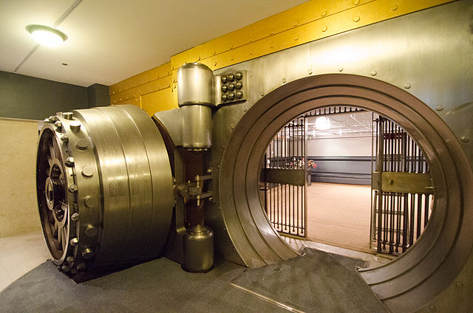
OAuth 2

Slide 52
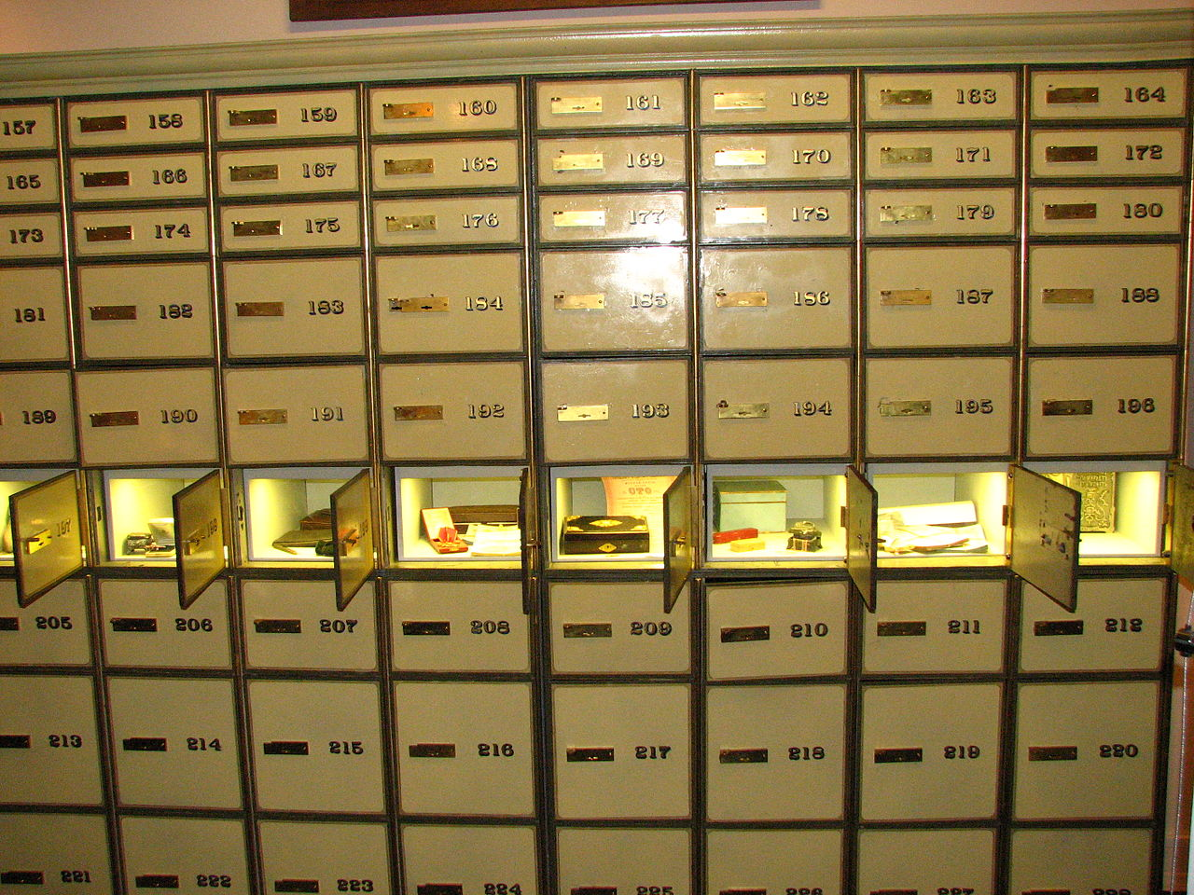

Slide 53
Login Page
Username + password
Hey! Here's your friends!
Delicious Data
End User
LinkBait.com
www.us.com
api.us.com

Slide 54
"Hey – this code works on my machine but it fails in production!"
"Your API keeps crashing every time we send requests to it."

Slide 55
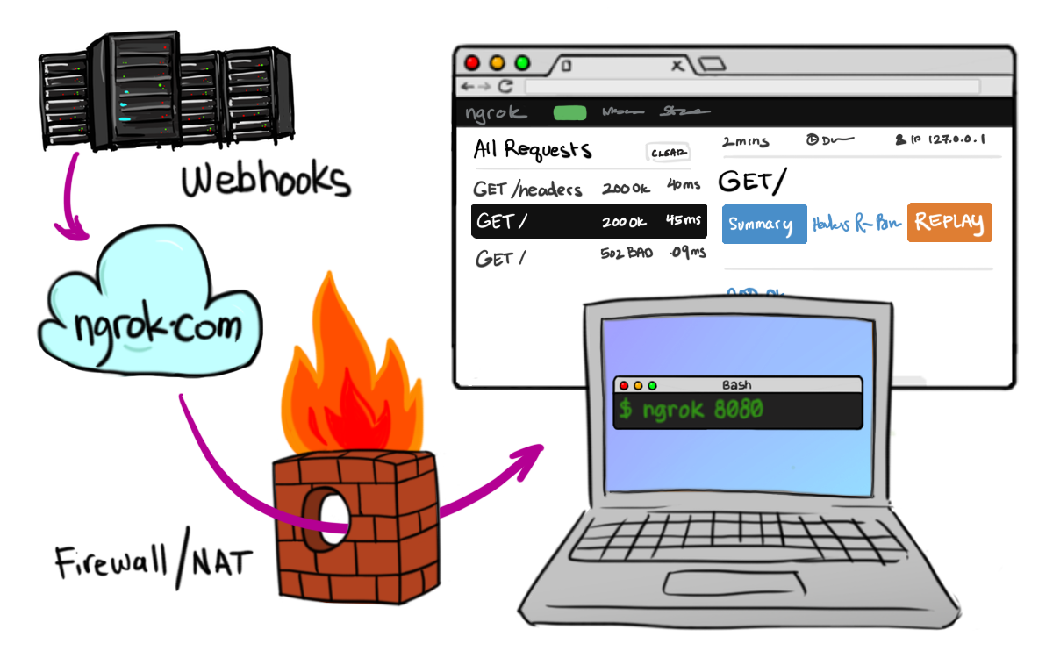
NGrok
https://ngrok.com/
Secure tunnels from the web to localhost

Slide 56
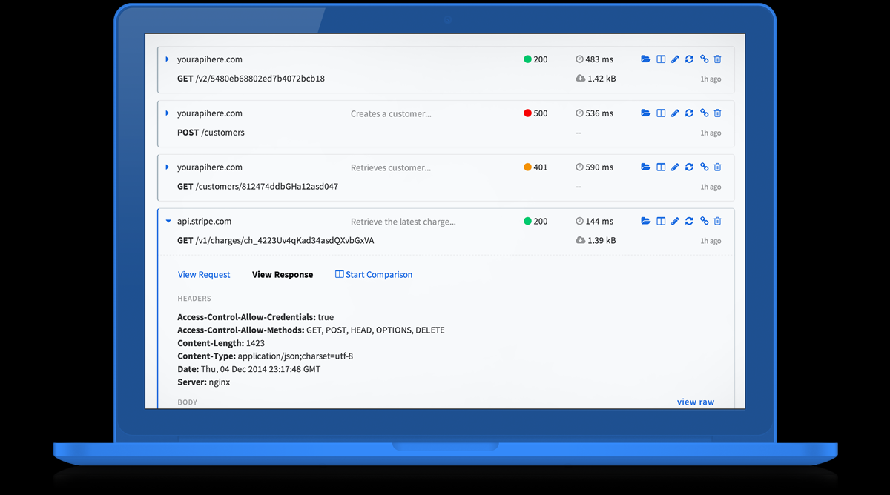
RunScope
https://www.runscope.com/
Monitoring and debugging for web APIs

Slide 57
Acknowledgements
Seb Lambla (@serialseb) for resource representation
The London .NET User Group (LDNUG)
Troy Hunt (@troyhunt)
http://www.troyhunt.com/2014/02/your-api-versioning-is-wrong-which-is.html
Mike Kelly <mike@stateless.co>
The HAL draft specification and hypermedia

Slide 58
"Almost everybody feels at peace with nature: listening to the ocean waves against the shore, by a still lake, in a field of grass, on a windblown heath. One day, when we have learned the timeless way again, we shall feel the same about our towns, and we shall feel as much at peace in them, as we do today walking by the ocean, or stretched out in the long grass of a meadow." — Christopher Alexander The Timeless Way of Building 1979

